Slide 1
Graphical User Interface - GUI
Java GUI can be implemented using many different Java API packages.
We will be using:
java.awt – Abstract Windows Toolkit
javax.swing – Lightweight and rich components
The basic GUI is built as a window that inherits from the class JFrame (javax.swing)
Properties of the Window are set using the JFrame class
Title
Size
Location (on the screen)

Slide 2
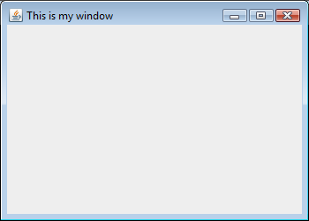
A Simple Window
This Window is built from the class JFrame in javax.swing
The Window class inherits from JFrame.
The title of the Window can be set in the constructor for JFrame.

Slide 3
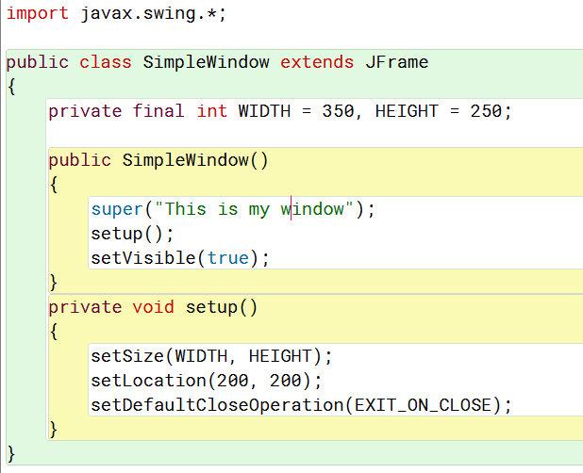
A Simple Window

Slide 4
Simple Example
Class SimpleWindow
Here we have a window with a title
The width and height of the window are set using setSize()
setLocation() determines where the window will be drawn on the screen
setDefaultCloseOperation() determines what will happen when the window is closed
setVisible() determines if the window is drawn on screen

Slide 5
Graphical User Interface - GUI
Windows contain Panels
The panels contain components e.g. Buttons
Within a window are invisible layers known as Panels
These Panels contain things like:
Buttons
Text boxes
Labels
Check boxes

Slide 6
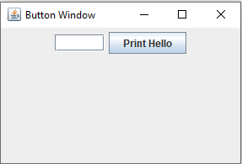
A Button Window
The Window contains a panel - MyPanel.
The panel inherits from JPanel, but you can’t see it!
The panel is outlined here – it sits as a layer in the window
The panel contains the Button and TextField

Slide 7
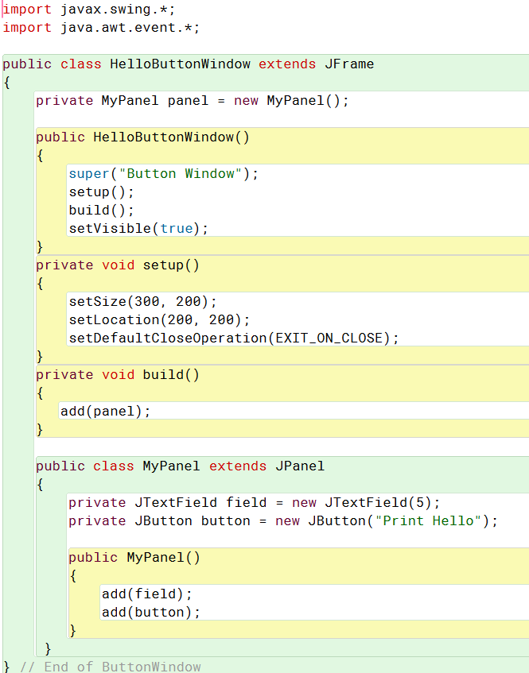
A Button Window
panel is an attribute of the Window
MyPanel is an inner class of the Window
MyPanel extends JPanel
Buttons and TextFields are attributes of the panel

Slide 8
GUI Overview
Containers: Windows inherit from JFrame
Panels inherit from JPanel
Components: Buttons are instances of JButton
Textboxes are instances of JTextField
Labels are instances of JLabel
For Swing Components
import javax.swing.*;
public class MyWindow extends JFrame
public class MyPanel extends JPanel
private JButton button= new JButton("Calculate");
private JTextField field = new JTextField(10);
private JLabel label = new JLabel(“Text to display”);

Slide 9
Swing Components
Components are textboxes, radio buttons, checkboxes etc Components are added to a panel and the panel is added to the window
First we create the panel
private MyPanel panel = new MyPanel();
Where
public class MyPanel extends JPanel

Slide 10
Swing Components
Components are textboxes, radio buttons, checkboxes etc Components are added to a panel and the panel is added to the window
Then we create the components as attributes of the panel:
private JButton button = new JButton(“Print Hello”);
Then we add the components to the panel
add(button);

Slide 11
Adding to a Window & Panel
If you forget to add your components, the Window will be empty!
panel is added to the window
Components are attributes of the panel
Use add() to add components to the panel

Slide 12
Buttons
Class ButtonWindow
A button has a label which is passed to the constructor for JButton
private JButton button = new JButton(“Print Hello");
The button is added to the panel
add(button);
Note: The 2 components are displayed(left to right) in the order that they are added to the panel (default layout)

Slide 13
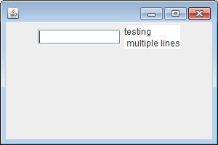
TextFields
Class TextWindow
Here we use an inner class MyPanel to hold a TextField with a width of 10 and a TextArea with multiline text
private JTextField field = new JTextField(10);
private JTextArea area = new JTextArea();
area.setText("testing \n multiple lines");

Slide 14
Swing Components – BlueJ Project
A Swing Components BlueJ Project is available in Canvas
Download and extract the project
Run all the different windows
Building a GUI requires practice and experimentation!
For further examples to try, refer to:
SwingComponents.zip

